Slide 1
Research Report
10/28/2023
Yu Li

Slide 2
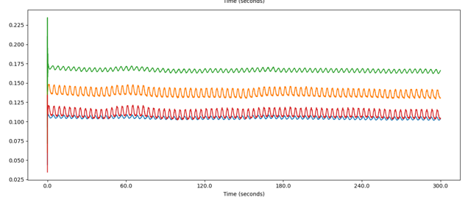
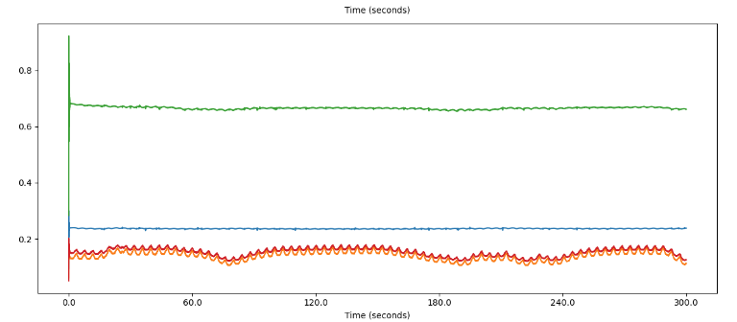

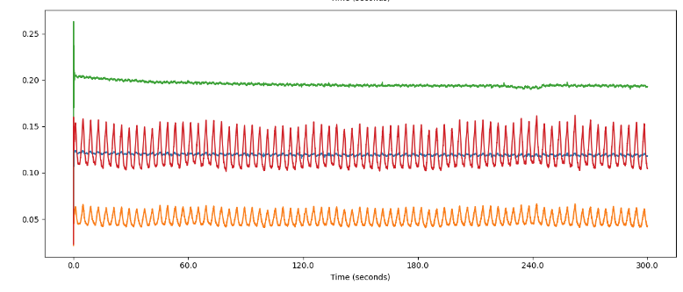

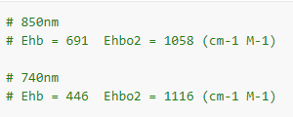


One subject check steps
Experimental raw data
Complete DC and AC parts
Under two wavelengths(740nm/850nm)
With two channels(different SD distances, set as 1cm and 10cm.
Steps:
1)Fitting real experimental data with simulated data.
2)Fitting at two wavelengths.
3)Spo2 check.

Slide 3

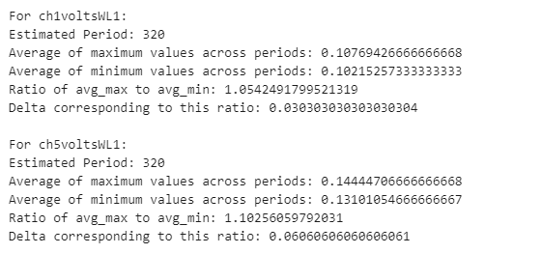
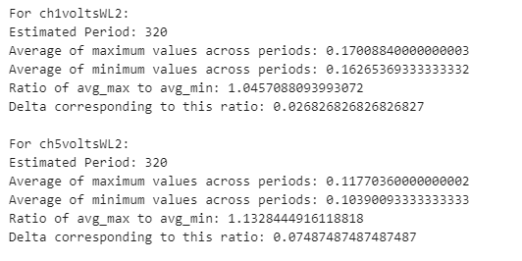
Data check
Some problems in the process:
1) Raw data WL1 is 740nm whereas our simulation WL1 is 735nm.
2) The number of photons in the simulation is 120M. We assume that the distribution of photons is the same but the calculated number of photons is also different, which will cause errors.
3) Different SD distances will lead to different L data, which will affect the final result.

Slide 4
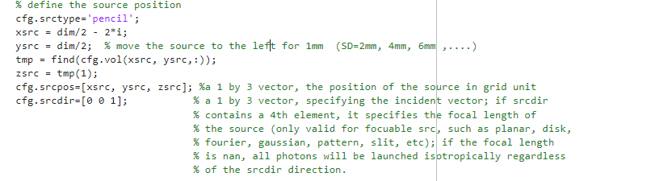



One subject check steps
Steps: 4)Different SD modified geometry/curvature.
In the function that sets the SD distance, there is a definition of the detector position.
By optimizing the function of the detector position, hope to try to fit the situation of the real experiment as much as possible.
Through optimization, we hope to find the relationship that best satisfies Spo2 check.
Spo2 values
Sheep1: 100%
Sheep2: 97%
Sheep3: 94%

Slide 5



Two subjects check steps
Short SD to get the fix Δμa
Long SD to focus on fetus
Run long SD distance, set μa of mom stable and focus on fetus.
Run short SD distance and know the parameter , based on the experiment data, we can get Δμa.
Plug the Δμa to the MC simulation and check (similar as the one subject) and get the fix Δμa.

